Slide 1
An Adaptive Collaborative Computing System for Distributed Deep Learning
Case study on Autonomous Vehicles and Robotic Arm in Smart Factory for Industry 4.0
Chia-Heng Tu
National Cheng Kung University
2018’ 3’ 7

Slide 2
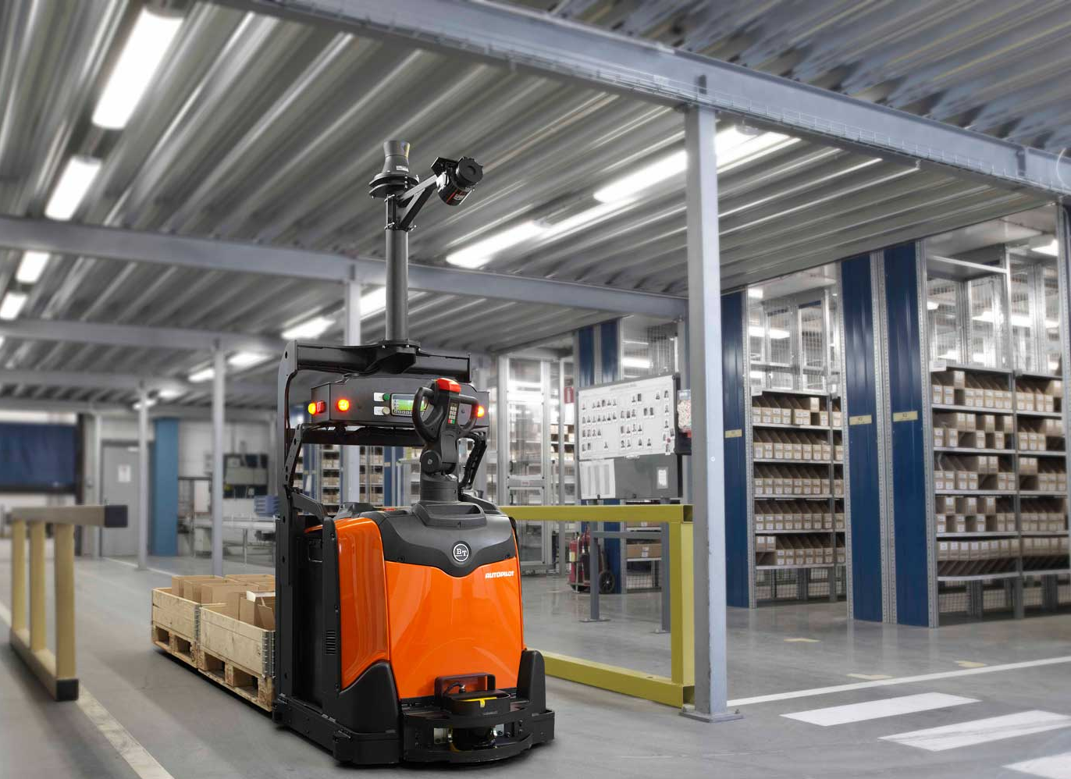
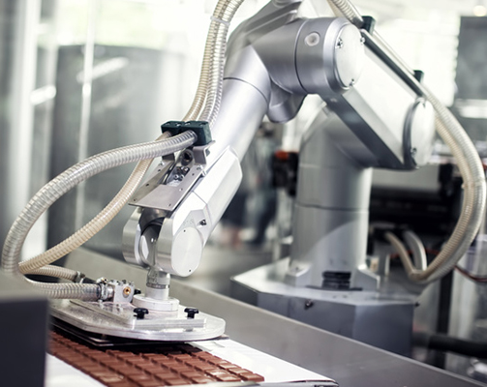
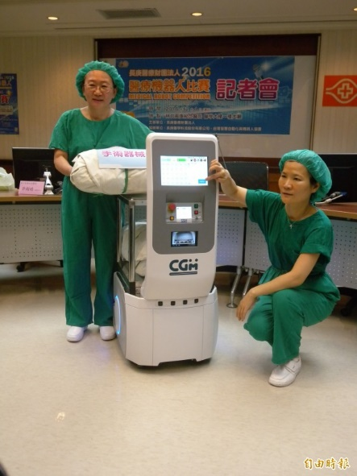
Demands of Computing Power for Smart Factory Applications
…
In factory or medical environments, there are multiple of autonomous devices
Each of devices may be responsible for multiple tasks, in addition to those of control purposes
To cope with the complex tasks,
complex hardware should be adopted to meet the timing requirements
which increases cost
One would always easy to buy the most expensive HW to take care of the tasks, e.g., 15K USD for a Drive PX2
To minimize the HW cost while the devices are able to handle assigned tasks
we propose the adaptive collaborative computing system
which distributes computing works on the device and if necessary, on the backend server
Apps on device #4
Object recognition
Apps on device #3
Object recognition
Apps on device #2
Object recognition
Color recognition
Apps on device #1
…
Object recognition
Color recognition
…
Color recognition
…
Color recognition
…
Example end devices: Autonomous vehicles for warehousing, robotic arms for manufacturing, and medical carts.
Courtesy of https://roboticsandautomationnews.com/wp-content/uploads/2016/05/cemat-staplerhersteller.jpg; https://roboticsandautomationnews.com/wp-content/uploads/2016/06/pixmap-industrial-robotic-pixmap-realtime-3d-mapping-augmented-reality.jpg

Slide 3
Adaptive Collaborative Computing System
Apps on device #4
Apps on device #4
Offload computation to server when necessary
E.g., low accuracy, low battery, …
Object recognition
Object recognition
Apps on device #3
Apps on device #3
Object recognition
Object recognition
Apps on device #2
Apps on device #2
Object recognition
Color recognition
Object recognition
Color recognition
Apps on device #1
Apps on device #1
…
…
Color recognition
Object recognition
Color recognition
Object recognition
…
Color recognition
…
Color recognition
…
Color recognition
…
Color recognition
…
…
Computation offloading
Distributed Deep Neural Network Computation Layer (DDNNCL)
End devices
Backend server(s)
Multiple end devices with limited computing power
One or more backend servers for handling tasks on behalf of the devices
OpenCL Runtime
Virtualized computing resources
(OpenCL Runtime)
Operating system (Drivers for accelerators)
Operating system (Drivers for accelerators)
In-door communication network (E.g., Ethernet)
Hardware platform
Hardware platform
CPU
Accelerators (E.g., GPU, FPGA, ASIC)
CPU
Mem
Accelerators (E.g., GPU, FPGA, ASIC)

Slide 4
Possible Research Directions
Apps on device #4
DNN models for new applications
Object recognition
Apps on device #3
Object recognition
Apps on device #2
Object recognition
Color recognition
Apps on device #1
…
Object recognition
Color recognition
…
Color recognition
…
Color recognition
Core of DDNN for partitioning works for devices and server
…
Distributed Deep Neural Network Computation Layer (DDNNCL)
Add OpenCL-enabled DDNN HW
End devices
Backend server(s)
Virtualizing & managing underlying HW(s). Memory management for multiple tasks executions
OpenCL (CUDA) Runtime
Virtualized computing resources
(OpenCL, CUDA Runtime)
Operating system (Drivers for accelerators)
Operating system (Drivers for accelerators)
In-door communication network
Hardware platform
Hardware platform
CPU
Accelerators (E.g., GPU, FPGA, ASIC)
CPU
Mem
Accelerators (E.g., GPU, FPGA, ASIC)
We have AMD S7150 & NVIDIA Titan Xp as the accelerators

Slide 5
Timeline
9/20
9/27
10/4
10/18
10/25
11/3?
11/7
Today:
Project briefing
Team building: who is onboard?
I send you my parts for you to review and add your materials
I receive your parts and perform 1st merge
2nd merge
We submit proposal (to MOST)
NCKU sends proposal to MOST
Currently, I got
a 2nd-year MS student dedicated for system development
a junior Ph.D. student for handling project-related general affairs

Slide 6
References
You will find everything I have in this Dropbox folder
Official information from MOST for the next phase is here
The slides for the meeting on 9/14 at MOST
Offline copy

Slide 7
What’s next?
Team building
Are you in?
Work distribution
I will handle the DDNN and OpenCL part
Short term goal: OpenCL-enabled DDNN in end devices in 1st year, DDNN extends to server side in 2nd year, …
The target application(s) for the system?
Autonomous vehicle (Prof. 莊, NCKU)
Medical application (Prof. 蔣, NCKU-CSIE)
Writing proposal
CM03
Compile budget list
Your advices and assistants are appreciated

Slide 8
Backup slides

Slide 9
Possible Research Directions
Apps on device #4
Object recognition
Apps on device #3
Object recognition
Apps on device #2
Object recognition
Color recognition
Apps on device #1
…
Object recognition
Color recognition
…
Color recognition
…
Color recognition
…
1.Core of DDNN for partitioning works for devices and server
Distributed Deep Neural Network Computation Layer (DDNNCL)
2.Support OpenCL-enabled DDNN HW accelerate
End devices
Backend server(s)
3.Virtualizing & managing underlying HW(s).
OpenCL (CUDA) Runtime
Virtualized computing resources
(OpenCL, CUDA Runtime)
Operating system (Drivers for accelerators)
Operating system (Drivers for accelerators)
In-door communication network
Hardware platform
Hardware platform
CPU
Accelerators (E.g., GPU, FPGA, ASIC)
CPU
Mem
Accelerators (E.g., GPU, FPGA, ASIC)
We have AMD S7150 & NVIDIA Titan Xp as the accelerators

Slide 10
…
Apps on device #4
Object recognition
Apps on device #3
Object recognition
Apps on device #2
Object recognition
Color recognition
Apps on device #1
…
Object recognition
Color recognition
…
Color recognition
…
Color recognition
…
Example end devices: Autonomous vehicles for warehousing, robotic arms for manufacturing, and medical carts.

Slide 11
…
Apps on device #4
Object recognition
Apps on device #3
Object recognition
Apps on device #2
Object recognition
Color recognition
Apps on device #1
…
Object recognition
Color recognition
…
Color recognition
…
Color recognition
…
Example end devices: Autonomous vehicles for warehousing & robotic arms for manufacturing

Slide 12
Computing Systems for Smart Environment Applications
Apps on device #4
Object recognition
Apps on device #3
Object recognition
Apps on device #2
Object recognition
Color recognition
Apps on device #1
…
Object recognition
Color recognition
…
Color recognition
…
Color recognition
…
End devices
Backend server(s)
Operating system
Operating system
Comm. network
Hardware platform
Hardware platform
CPU
Mem
Input & Output devices
CPU
Mem
Input & Output devices

Slide 13
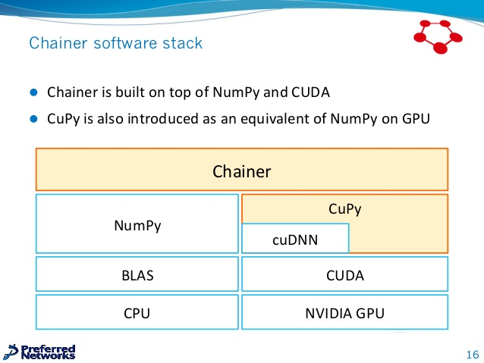
DDNN Internal
Distributed Deep Neural Network Computation Layer (DDNNCL)
DDNN framework
NumPy
CModelGenerator
OCLPy
CuPy
PyOpenCL
clBLAS
cuDNN
cuBLAS
clBLAS
BLAS
HW computation acceleration layer (OpenCL)
NVIDIA computation acceleration layer (CUDA)

Slide 14
DDNN across machines
End device #3
Handling App X w/ DDNNCL at devices & server
App X (DDNNCL)
mpi4py
…
Operating system
inputs
output
…
…
Hardware platform
End devices
Aggregation
Backend server
End device #2
App X (DDNNCL)
mpi4py
Operating system
Hardware platform
End device #1
Backend server
App X (DDNNCL)
App X (DDNNCL)
App Y (DDNNCL)
App Z (DDNNCL)
mpi4py
Aggregation
mpi4py
Operating system
Operating system
Hardware platform
Hardware platform

Slide 15




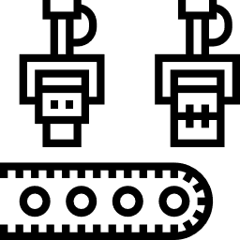



IP Cameras
1
2
3
4
5
6
Backend server
7
8
http://icons.iconarchive.com/icons/iconsmind/outline/128/Security-Camera-icon.png
https://visualpharm.com/free-icons/server-595b40b85ba036ed117db089
https://www.flaticon.com/free-icons/factory_20274

Slide 16
Asrlab new AI
IP Cameras
1
2
3
4
Backend server
5
http://icons.iconarchive.com/icons/iconsmind/outline/128/Security-Camera-icon.png
https://visualpharm.com/free-icons/server-595b40b85ba036ed117db089
https://www.flaticon.com/free-icons/factory_20274

Slide 17
Apps on device #4
Object recognition
Apps on device #3
Object recognition
Apps on device #2
Object recognition
Color recognition
Apps on device #1
…
Object recognition
Color recognition
…
Color recognition
…
Color recognition
…
Distributed Deep Neural Network Computation Module (DDNNCM)
End devices
Backend server(s)
CModelGenerator
OCLPy
OCLPy
CuPy
clBLAS
PyOpenCL
clBLAS
PyOpenCL
clBLAS
cuDNN
cuBLAS
OpenCL (CUDA) Runtime
Virtualized computing resources
(OpenCL, CUDA Runtime)
Operating system (Drivers for accelerators)
Operating system (Drivers for accelerators)

Slide 18
Apps on device #4
Object recognition
Apps on device #3
Object recognition
Apps on device #2
Object recognition
Color recognition
Apps on device #1
…
Object recognition
Color recognition
…
Color recognition
…
Color recognition
…
Distributed Deep Neural Network Communication Module (DDNNCM)
End devices
Backend server(s)
Cmodel Generator
CUDA Multiple-Process Service (MPS)
OpenCL Optimizer
Virtualized computing resources
(OpenCL, CUDA Runtime)
OpenCL Runtime
Operating system (Drivers for accelerators)
Operating system (Drivers for accelerators)

Slide 19
End device #4
End device #3
End device #2
End device #1
Backend server
DDNN Apps on device #1
DDNNCF – Server Module
Object recognition
Color recognition
…
Device Module generator
Remote exec. module
(Python; Chainer)
DDNNCF – Device Module
Local exec. module
(C or OCL)
Comm. module
(C/Client)
MQTT Server
(Python/ Broker)
…
entropy
OCL
Runtime
CUDA/OCL Runtime
Operating system (Drivers for accelerators)
…
Operating system (Drivers for accelerators)

Slide 20
End device #4
End device #3
End device #2
End device #1
DDNN Apps on device #1
Backend server
Server module
Object recognition
Color recognition
…
Inference server
(MQTT server)
DNN framework (E.g., Chainer)
Device module
DDNN model
generator
Generated DDNN models
DNN C library
(E.g., TinyDNN & eBNN)
Tool library
(Entropy, communication & OpenCL support)
DDNN model DB & Model inference acceleration
…
OCL
runtime
CUDA/OCL runtime
Operating system (Drivers for accelerators)
…
Operating system (Drivers for accelerators)

Slide 21

Camera
(End device)
Server
Physical world
Input from Camera
Conv. layer
Max pooling
Conv. layer
Max pooling
Conv. layer
Max pooling
Conv. layer
Fully connected
Ans: John
Fully connected
No
Ans: Mary
Model inference operations
Is confident?
Partial layers processed by Server
Yes
Output
Ans: John
Partial layers processed by Camera

Slide 22
connect
Backend server(s)
End devices
Broker
connectack
PUBLISH TOPIC1
create
Thread
SUBSCRIBE TOPC1
···
SUBSCRIBE TOPIC2
Thread
disconnect
High-level view of a DDNN App run by device and server
…
inputs
output
…
…
End device #1
Server

Slide 23
CONNECT
Backend server(s)
End devices
Broker
CREAT
CONNACK
Thread
SUBSCRIBE TOPIC1
SUBSCRIBE TOPIC2
SUBACK
SUBACK
PUBLISH TOPIC1
PUBLISH TOPIC1
PUBLISH TOPIC2
PUBLISH TOPIC2
···
DISCONNECT

Slide 24
CONNECT
CONNECT
Backend server
End device
MQTTBroker
Remote Execution Module
Device Module
CONNACK
CONNACK
SUBSCRIBE TOPIC-B
SUBSCRIBE TOPIC-A
SUBACK
SUBACK
PUBLISH TOPIC-A
PUBLISH TOPIC-A
PUBLISH TOPIC-B
PUBLISH TOPIC-B
DISCONNECT
DISCONNECT

Slide 25
XXX: Message tag (i.e., T) should be design carefully to
get the inference data at certain device at certain time
Tool library in device module at end device #1 (MQTT Client)
Inference server (MQTT Broker)
A handler thread in model inference acceleration module (MQTT Client)
server_inference (…)
Pack the data required by the inference at server: model_name, x, num_layer
Connect to the broker
Publish the packed data to the broker
Subscribe to get the inference result, y
Wait and return the result, y, upon receiving it
Register the subscriber and its topic, T
Send ACK message to the subscriber
Connect to the broker
Subscribe to handle the requests for end device #1
Load all the models available in end device #1
Wait for receiving the request
Perform inference of the model_name from the num_layer-th layer with the input x at server
Publish the predicting result, y, to end device #1
Subscribe T
Forward the data to the subscriber of topic, T
Publish T (Payload = model_name, x, num_layer)
Publish T (Payload = model_name, x, num_layer)
Register the subscriber and its topic, T’
Send ACK message to the subscriber
Subscribe T’
Publish T’ (Payload =
model_name, y)
Forward the data to the subscriber of topic, T’
Publish T’ (Payload =
model_name, y)

Slide 26
Exit 3
Cloud
Linear
Conv 3x3
Linear
Exit 2
Edge
Conv 3x3
Conv 3x3
Conv 3x3
Conv 3x3
Exit 1
Linear
Linear
Exit 1
Conv 3x3
Conv 3x3
End devices
Conv 5x5
Conv 5x5

Slide 27
Conv
Conv
Conv
Conv
Conv
Conv
End device
(device inference)
Linear
Local Exit
End device
(device inference)
Linear
Local Exit
Server
(server inference)
Server
(server inference)
Conv
Conv
Conv
Conv
Linear
Linear
Server Exit
Server Exit

Slide 28
1
2
3
4
1
2
3
4
1
2
3
4
IP Cameras
IP Cameras
IP Cameras
Backend server
Backend server
Backend server
1-to-1 Model
Many-to-1 Model
Hybrid Model

Slide 29
Training phase at server side
XXX: Is Configure_model() the function name in model.py?
Configure_model () :
model.py
XXX: For paper usage, please convert the font of every text in the slides into Times New Roman
ef = end filters
el = end layers
cf = cloud filters
cl = cloud layers
nepoch = n
Input
XXX: We know Embedded layers use eBNN links. But, what are the Cloud layers? eBNN links or Chainer standard links w/ float types?
Embeded layer
Sequential.py
Setup_model () :
The Sequential Class constructs the model based on user’s configurations, e.g., ef, el, cf, cl
The add() method appends the new link (network layer) to the model
fconv
model = Sequential()
add “ConvPool” in model
for i in el :
add “BinaryConvPool” in model
branch = Sequential()
add “BinaryLinear” in branch
add branch in model
for i in cl :
add ”Convolution2D” in model
add “max_pooling_2d” in model
add “BatchNormalization” in model
add “Activation(‘relu’)” in model add “Linear” in model
bconv
.
.
.
*el
Early exit point
Chain.py
XXX: What is the purpose of Chain class?
XXX: Purpose???
Define the operations for Sequential model, e.g., train, inference, save and load
Add the model (Sequential object) into the chain object
Do the training process, i.e., forward propagation, loss, backward propagation
Cloud layer
blinear
Local Exit
Conv2D
maxpool
XXX: Is a cloud layer containing the four links, Conv2D, maxpool, BatchNormal and Activation?
Training () :
*cl
chain = Chain( ent_T = entropy )
add model in chain
for i in nepoch :
do chain forward propagation
do chain loss function
do chain backward propagaton
Model.npz
Batch
Normal
Iterate over the NN layers in the built model (in chain object) and save them into npz file format (NOTE: only parameters of the layers are saved)
Activation
XXX: We can emphasize on the portability support of the code generation. For example, we can generate the code for TinyDNN
.
.
.
Save_model () :
Cloud exit point
for i in chain.model.length :
Save NN layers in chain as npz file format
Inference.h
Linear
Cloud Exit
Generate_C () :
Generate the C code for the trained model by injecting the code sequence of function calls to the defined layers
These function calls will invokes the C-based NN layers implementations defined in 3rd party library, such as eBNN or TinyDNN (XXX: check the RED text in the left.)
Generate C function calls of the built model into “inference.h”

Slide 30
Inference :
End layer
main.c
ebnn_compute( image ) :
ebnn.h (Enhanced)
Function.h
Input ( n , d , w , h )
fconv_layer( x ) :
do Convpool link with x
layer + 1
bconv_layer( x ) :
do BinaryConvpool link with x
layer + 1
blinear_layer( x ) :
do BinaryLinear link with x
if( enropy( x ) < ent_T )
pass_cloud( x , layer )
entropy( x ) :
compute entropy with x
pass_cloud( x , layer )
package x and layer as data
call model.py append data
inference.h
fconv
ebnn_compute( x ) :
fconv_layer( x )
bconv_layer( x )
. . .
blinear_layer( x )
Return x
bconv
.
.
.
x el
Result 1
x(n , 10)
x ( n , f , w , h )
blinear
Earily exited
point
data[x , layer]
x(n , f , w , h)
If classify confidence is not enough
Cloud layer
model.py
chain.py
Conv2D
_init_() :
if(model non-exist)
load model from npz
_call_( data ) :
x = con_eval( data )
Return x
con_eval( data ) :
convert data x and layer
Return evaluate( x , layer)
maxpool
Batch
Normal
x cl
sequential.py
Atication
evaluate( x , layer ) :
for link in links[ layer : ]
x = link( x )
Return x
.
.
.
The links is define with sequential object
by setup_model() in training
Result 2
x(n , 10)
Final exited
point
Receive the data from cloud to end
Linear
End layer

Slide 31
dev_model_infer.c
An example of a trained DDNN model
#include “dnn_c_lib.h”
#include “tool_lib.h”
#define NUM_DEV_LAYERS 2
#define ENTROPY_THRE t
float*[] device_inference (float* x[]) {
y1 = conv_layer (x);
y2 = conv_layer (y1);
y3 = linear_layer (y2);
if (enropy(y3) > ENTROPY_THRE)
y3 = req_server_inference (y2, NUM_DEV_LAYERS);
return y3;
}
Conv
Conv
End device
(device_inference)
BLinear
Local Exit
Server
(server_inference)
Conv
Conv
Linear
Server Exit
dnn_c_lib.h
tool_lib.h
// C impl. of the convolution layer.
float*[] conv_layer (float*[] x) {
y = convolution (x);
return y;
}
…
// C impl. of the fully connected layer.
float*[] linear_layer (float*[] x) {
y = linear (x);
return y;
}
…
#include “mqtt.h”
#define SERVER_IP 192.168.1.1
float entropy (float*[] x) {
return cal_entropy(x);
}
float*[] req_server_inference (float*[] x, int num_layer ) {
char[] payload = Convert2Char(x)+
Convert2Char(num_layer);
server = mqtt_connect(SERVER_IP);
mqtt_send(server, payload);
mqtt_recv(server, y);
return y;
}

Slide 32
An example of a trained DDNN model
dev_model_infer.c
#include “dnn_c_lib.h”
#include “tool_lib.h”
#define NUM_DEV_LAYERS 2
#define ENTROPY_THRE t
float*[] device_inference (float* x[]) {
y1 = conv_layer (x);
y2 = conv_layer (y1);
y3 = linear_layer (y2);
if (enropy(y3) > ENTROPY_THRE)
y3 = req_server_inference (y2, NUM_DEV_LAYERS);
return y3;
}
Conv
Conv
End device
(device_inference)
Linear
Local Exit
Server
(server_inference)
Conv
Conv
tool_lib.h
#include “mqtt.h”
#define SERVER_IP 192.168.1.1
mqtt_obj server;
void platform_init () {
server = mqtt_connect(SERVER_IP);
}
void platform_final () {
mqtt_disconnect(server);
}
float entropy (float*[] x) {
return cal_entropy(x);
}
float*[] req_server_inference (float*[] x, int num_layer ) {
char[] payload = Convert2Char(x)+
Convert2Char(num_layer);
mqtt_publish(server, payload);
mqtt_recv_subscribed_msg(server, y);
return y;
}
Linear
Server Exit
dnn_c_lib.h
// C impl. of the convolution layer.
float*[] conv_layer (float*[] x) {
y = convolution (x);
return y;
}
…
// C impl. of the fully connected layer.
float*[] linear_layer (float*[] x) {
y = linear (x);
return y;
}
…
Modify tool_lib.h

Slide 33
main.c
ebnn_compute( image ) :
ebnn.h (Enhanced)
Function.h
fconv_layer( x ) :
do Convpool link with x
layer + 1
bconv_layer( x ) :
do BinaryConvpool link with x
layer + 1
blinear_layer( x ) :
do BinaryLinear link with x
if( enropy( x ) < ent_T )
pass_cloud( x , layer )
entropy( x ) :
compute entropy with x
pass_cloud( x , layer )
package x and layer as data
call model.py append data
inference.h
ebnn_compute( x ) :
fconv_layer( x )
bconv_layer( x )
. . .
blinear_layer( x )
Return x
device_model.c
dnn_c_lib.h (Enhanced)
tool_lib.h
#include “dnn_c_lib.h”
#define NUM_DEV_LAYERS 2
#define ENTROPY_THRESHOLD t
int*[] main (int* x[]) {
y1 = conv_layer (x);
y2 = conv_layer (y1);
y3 = linear_layer (y2, NUM_DEV_LAYERS, ENTROPY_THRESHOLD);
return y3;
}
#include “tool_lib.h”
int*[] conv_layer (int*[] x) {
y = convolution (x);
return y;
}
int*[] linear_layer (int*[] x, int num_layer, int t) {
y = linear_layer(x);
if( enropy( y ) < t )
server_inference (x, num_layer);
return y;
}
#include “mqtt.h”
#define SERVER_IP 192.168.1.1
int entropy(int*[] x) {
return entropy(x);
}
int*[] server_inference(int*[] x, int num_layer ) {
char* payload = Convert2Char(x)+
Convert2Char(num_layer);
server = mqtt_connect(SERVER_IP);
mqtt_send(server, payload);
mqtt_recv(server, y);
return y;
}

Slide 34
We may follow the DDNN paper to present our work.
They list the key steps in DDNN inference in Section III.D
We can use it as example to illustrate DDNN training procedure
In our DDNN inference, we can show the code a little bit to present the idea
eBNN.h and Inference.h
Section III.D….
We now provide an example of the inference procedure
for a DDNN which has multiple end devices and three exit
points (configuration (e) in Figure 2):
1) Each end device first sends summary information to
local aggregator.
2) The local aggregator determines if the combined summary
information is sufficient for accurate classification.
3) If so, the sample is classified (exited).
4) If not, each device sends more detailed information
to the edge in order to perform further processing for
classification.
5) If the edge believes it can correctly classify the sample
it does so and no information is sent to the cloud.
6) Otherwise, the edge forwards intermediate computation
to the cloud which makes the final classification.

Slide 35
Exit 3
Exit 3
Linear
Linear
Conv 3x3
Conv 3x3
Linear
Exit 2
Linear
Exit 2
Conv 3x3
Conv 3x3
Conv 3x3
Conv 3x3
Linear
Exit 1
Linear
Exit 1
Conv 3x3
Conv 3x3
Conv 5x5
Conv 5x5

Slide 36
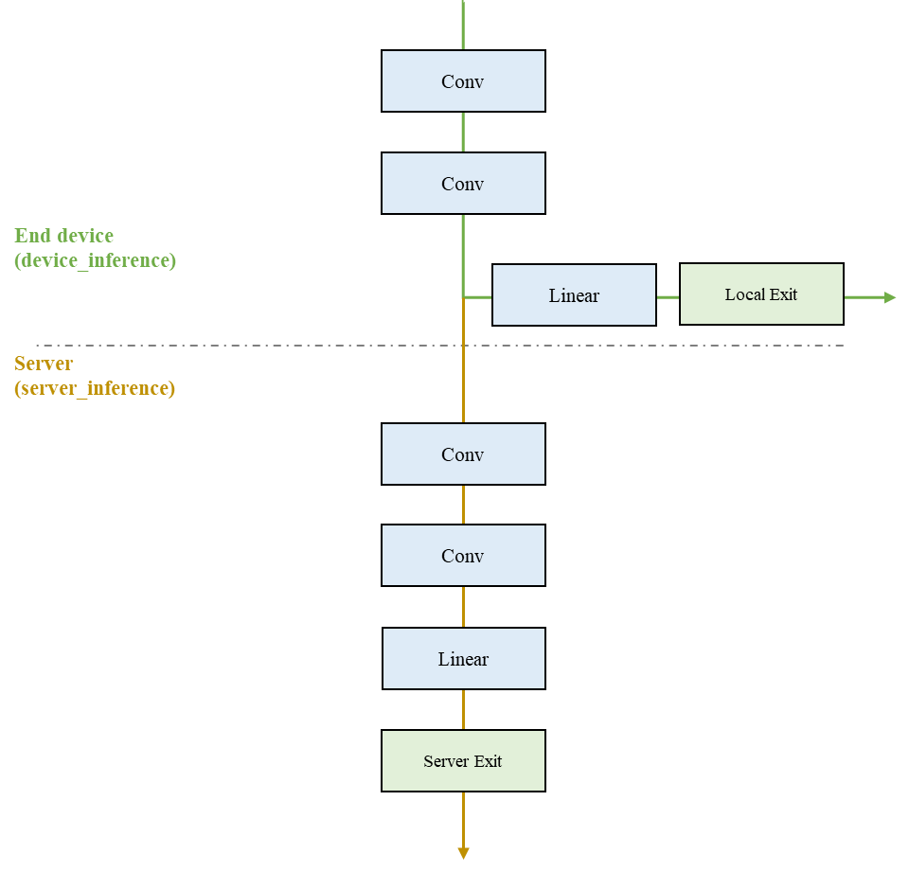
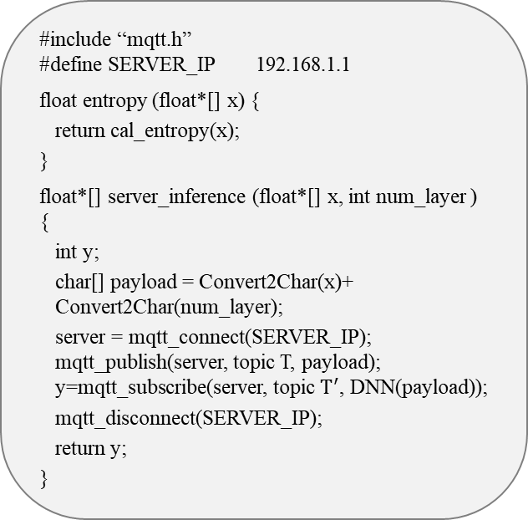
dev_model_infer.c
An example of a trained DDNN model
#include “dnn_c_lib.h”
#include “tool_lib.h”
#define NUM_DEV_LAYERS 2
#define ENTROPY_THRE t
float*[] device_inference (float* x[]) {
y1 = conv_layer (x);
y2 = conv_layer (y1);
y3 = linear_layer (y2);
if (enropy(y3) > ENTROPY_THRE)
y3 = server_inference (y2, NUM_DEV_LAYERS+1);
return y3;
}
Conv
Conv
End device
(device_inference)
Linear
Local Exit
Server
(server_inference)
Conv
Conv
Linear
Server Exit
dnn_c_lib.h
tool_lib.h
// C impl. of the convolution layer.
float*[] conv_layer (float*[] x) {
y = convolution (x);
return y;
}
…
// C impl. of the fully connected layer.
float*[] linear_layer (float*[] x) {
y = linear (x);
return y;
}
…
#include “mqtt.h”
#define SERVER_IP 192.168.1.1
float entropy (float*[] x) {
return cal_entropy(x);
}
float*[] server_inference (float*[] x, int num_layer ) {
int y;
char[] payload = Convert2Char(x)+ Convert2Char(num_layer);
server = mqtt_connect(SERVER_IP);
mqtt_publish(server, topic T, payload);
y=mqtt_subscribe(server, topic $T^{′}$, DNN(payload));
mqtt_disconnect(SERVER_IP);
return y;
}

Slide 37
Conv
Conv
Conv
Conv
Conv
Conv
End device
(device inference)
End device
(device inference)
BLinear
Local Exit
BLinear
Local Exit
Server
(server inference)
Server
(server inference)
Conv
Conv
Conv
Conv
Linear
Linear
Server Exit
Server Exit

Slide 38
FConv
FConv
End device
(device inference)
BLinear
Local Exit
BConv
End device
(device inference)
Server
(server inference)
BLinear
Local Exit
Server
(server inference)
Conv2D
Conv2D
Activation “relu”
Max_pool
Conv2D
x4
Activation “bst”
Activation “relu”
x2
Batch Normol
Max_pool
Linear
Linear
Server Exit
Server Exit

Slide 39





1
2
3
4
1
2
3
4
1
2
3
4
IP Cameras
IP Cameras
IP Cameras
Backend server
Backend server
Backend server
1-to-1 Model
Many-to-1 Model
Hybrid Model

Slide 40
XXX: Message tag (i.e., T) should be design carefully to
get the inference data at certain device at certain time
Tool library in device module at end device #1 (MQTT Client)
Inference server (MQTT Broker)
A handler thread in model inference acceleration module (MQTT Client)
CONNECT
Send CONNACK to clients
Register the subscriber and its topic, T
Send ACK message to the subscriber
CONNACK
Connect to the broker
Subscribe to handle the requests for end device #1
Load all the models available in end device #1
Wait for receiving the request
Perform inference of the model_name from the num_layer-th layer with the input x at server
Publish the predicting result, y, to end device #1
server_inference (…)
Pack the data required by the inference at server: model_name, x, num_layer as payload
Connect to the broker
Publish the packed data to the broker
Subscribe to get the inference result, y
Wait and return the result, y, upon receiving it
Subscribe T
CONNECT
SUBACK
CONNACK
Publish T (Payload = model_name, x, num_layer)
Forward the data to the subscriber of topic, T
Publish T (Payload = model_name, x, num_layer)
Register the subscriber and its topic, T’
Send ACK message to the subscriber
Subscribe T’
Publish T’ (Payload = model_name, y)
Forward the data to the subscriber of topic, T’
Publish T’ (Payload = model_name, y)

Slide 41
Tool library in device module at end device #1 (MQTT Client)
A handler thread in model inference acceleration module (MQTT Client)
Inference server (MQTT Broker)
server_inference (…)
Pack the data required by the inference at server: model_name, x, num_layer as payload
Publish the packed data to the broker
Subscribe to get the inference result, y
Wait and return the result, y, upon receiving it
Subscribe to handle the requests for end device #1
Load all the models available in end device #1
Wait for receiving the request
Perform inference of the model_name from the (num_layer +1) th layer with the input x at server
Publish the predicting result, y, back to end device #1
Register the subscriber and its topic, T
Subscribe T
Publish T (Payload = model_name, x, num_layer)
Forward the data to the subscriber of topic, T
Publish T (Payload = model_name, x, num_layer)
Subscribe T’
Register the subscriber and its topic, T’
Publish T’ (Payload = y)
Publish T’ (Payload = y)
Forward the data to the subscriber of topic, T’

Slide 42
Tool library in device module at end device #1 (MQTT Client)
A handler thread in model inference acceleration module (MQTT Client)
Inference server (MQTT Broker)
server_inference (…)
Pack the data required by the inference at server: model_name, x, num_layer as payload
Publish the packed data to the broker
Subscribe to get the inference result, y
Wait and return the result, y, upon receiving it
Register the subscriber and its topic, T
Subscribe to handle the requests for end device #1
Load all the models available in end device #1
Wait for receiving the request
Perform inference of the model_name from the (num_layer +1) th layer with the input x at server
Publish the predicting result, y, back to end device #1
Subscribe T
Publish T (Payload = model_name, x, num_layer)
Publish T (Payload = model_name, x, num_layer)
Forward the data to the subscriber of topic, T
Subscribe T’
Register the subscriber and its topic, T’
Publish T’ (Payload = y)
Publish T’ (Payload = y)
Forward the data to the subscriber of topic, T’

Slide 43
1
2
3
Backend server
…
IP Cameras

